Slide 1
Library Website Design Trends
Louisiana and other Southeastern Academic Libraries

Slide 2
About Me
Dave Comeaux
Web Services Librarian
Tulane University
Responsible for oversight of content and design of the library’s web presence for the main library website and several related sites
Interests in content management, usability and accessibility

Slide 3
Libraries Studied
Louisiana Four-Year Colleges (Public and Private)
Centenary | Northwestern
Grambling | OLOHCC
La College | OLOTL
Louisiana Tech | SJASC
Loyola | Southeastern
LSU | SUNO
LSU Shreveport | Tulane
LSU-Alexandria | UL-Lafayette
McNeese State | UL-Monroe
Nicholls State | UNO
NOBTS | Xavier
Notes:
This is the list of Louisiana colleges…

Slide 4
Libraries studied
Auburn University | University of Florida
Clemson University | University of Georgia
College of William and Mary | University of Kentucky
Duke University | University of Louisville
East Carolina University | University of Maryland
Emory University | University of Memphis
Florida International University | University of Miami
Florida State University | University of Mississippi
George Mason University | UNC- Chapel Hill
Georgia Institute of Technology | UNC- Charlotte
Georgia State University | UNC- Greensboro
Johns Hopkins University | University of South Carolina
Louisiana State University | University of South Florida
Mississippi State University | University of Tennessee - Knoxville
North Carolina State University | University of Virginia
Tulane University | Vanderbilt University
University of Alabama | Virginia Commonwealth University
University of Alabama - Birmingham | Virginia Tech
University of Central Florida | Wake Forest University
ASERL University Library Sites
A regional consortium of southeastern research libraries
Includes small and large privates, state flagships and regional libraries
Notes:
And the list of ASERL University Libraries…

Slide 5
Web Design Trends Studied
Content Management Systems
Integrated Search
Web-Scale Discovery
Navigation Design
Use of Social Media
Notes:
The trends I’m going to discuss are:
the adoption of content management systems;
the use of an integrated search box (i.e. allowing users to search for library resources, such as books, from the library home page);
the implementation of a web-scale discovery system;
The headings used to group links on a site’s main navigation
The use of social media (reflected on the home page)
And finally, the use of a rotating carousel to feature library items

Slide 6
Content Management Systems
Definitions
A Content Management System (CMS)[is a computer program that allows publishing, editing and modifying content on a web site as well as maintenance from a central interface. Such systems of content management provide procedures to manage workflow in a collaborative environment.
(Wikipedia)

Slide 7
Content Management Systems
Definitions
A software application used to upload, edit, and manage content displayed on a website. A content management system can perform a variety of different tasks for a website including regulating when content is displayed, how many times the content is shown to a specific user, and managing how the content connects or interacts with other elements of the website. This software also enables less technical individuals to manage content on a website easily without having an extensive coding background. Read more: http://www.businessdictionary.com/definition/content-management-system-CMS.html#ixzz292VyGfZl

Slide 8
Content Management Systems
Cost/Benefits
Benefits:
Standardizing web pages by following a common template or group of templates
Enabling non-technical staff to update department pages (less work for the web manager)
Allows control of what content is displayed based on roles
Costs
Requires an investment of time upfront to choose and implement a system and develop templates
Requires permission management (i.e., giving publishers enough permissions to update pages, but not enough to do harm)
Requires training for publishers
Notes:
Example of showing web publishing training only to logged in users

Slide 9
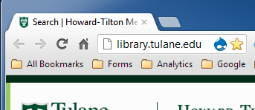
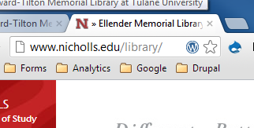
Content Management Systems
Methodology – Chrome Sniffer
It is very good at detecting open-source and most proprietary systems.
It cannot detect a “home-grown” system.
Notes:
To determine if a site uses a CMS, I installed the Chrome Sniffer extension. This extension examines a page’s source code and displays an icon to represent the technologies it finds on the page. If a CMS is detected, the corresponding icon is displayed in the address bar.
It is very good at detecting open-source and most proprietary systems. It cannot detect a “home-grown” system though.

Slide 10
Content Management Systems
Of the 22 Louisiana library sites, 6 use a CMS.
* indicates library site is part of university’s CMS
La College | Drupal *
Tulane | Drupal
McNeese State | Libguides
Northwestern | Silverstripe *
LSU-Alexandria | SiteFinity *
Nicholls State | WordPress *
Notes:
Two use Drupal, La. College and Tulane. La College’s library site is part of the college’s site which is also on Drupal. Tulane has a separate web presence from the university, which uses a proprietary CMS.
McNeese uses LibGuides, which is better known as a course and subject guide utility.
Nicholls

Slide 11
Content Management Systems
Of the 38 ASERL library sites, 10 use a CMS.
* indicates library site is part of university’s CMS
Florida International University | DotNetNuke
College of William and Mary | Drupal
Emory University | Drupal
North Carolina State University | Drupal
Tulane University | Drupal
University of Alabama | Drupal
University of North Carolina at Charlotte | Drupal *
University of Louisville | Plone *
University of Miami | Wordpress
University of South Florida | Wordpress
Notes:
Drupal is the most popular with 6 sites. Next comes WordPress with 2 sites. Two sites use the same CMS as the university.

Slide 12
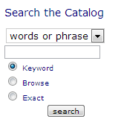
Integrated Search
A search box on a library home page
Single box for catalog

Slide 13
Integrated Search
Single box for multiple sources (Discovery)
Notes:
It could also be a single search box directed to a Web-Scale Discovery tool. This example is from McNeese State’s library home page.

Slide 14
Integrated Search
Tabbed Search
Notes:
Or it could be what is commonly referred to as a “Tabbed Search” interface. This type of interface weaves several search targets into a single box, but includes clickable tabs that allow users to select one target repository. Tulane has one, as well as LSU and Louisiana Tech.

Slide 15
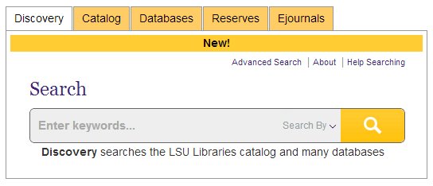
Integrated Search
Notes:
Or it could be what is commonly referred to as a “Tabbed Search” interface. This type of interface weaves several search targets into a single box, but includes clickable tabs that allow users to select one target repository. Tulane has one, as well as LSU and Louisiana Tech.

Slide 16
Louisiana - Integrated Search
16 sites have an integrated search of some kind.
9 search the catalog only
2 search Google Scholar
(Centenary)

Slide 17
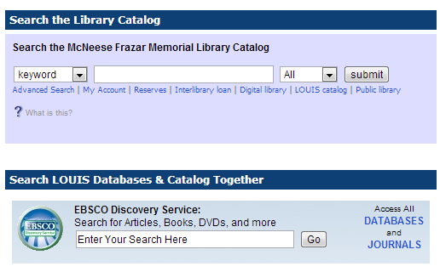
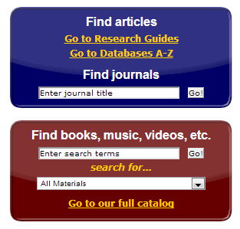
Louisiana - Integrated Search
2, McNeese and Loyola, have multiple search boxes

Slide 18
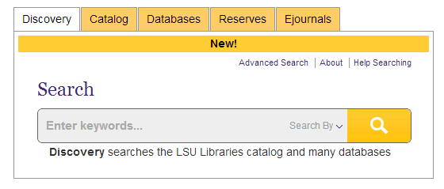
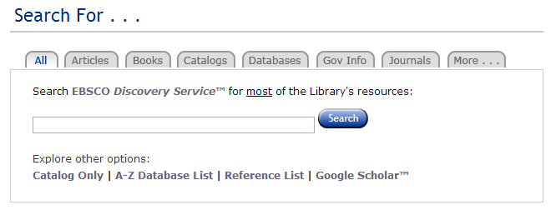
Integrated Search
3, LSU ,Tulane, and La. Tech have tabbed search boxes

Slide 19
ASERL - Integrated Search
All 38 sites have an integrated search of some kind on the main library’s home page.
8 are “single” search boxes
1 (Georgia Tech) searches the catalog only
The other 7 search a discovery tool or next-generation catalog
Virginia has created a custom results page

Slide 20
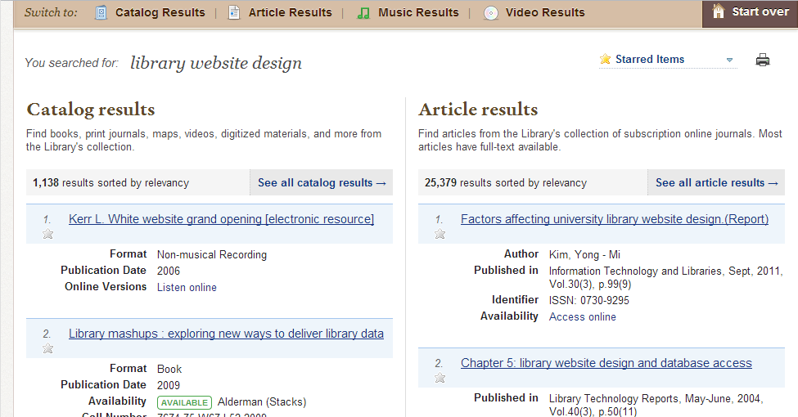
ASERL - Integrated Search

Slide 21
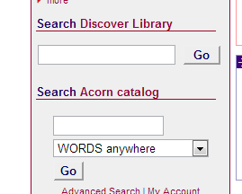
ASERL - Integrated Search
1, Vanderbilt, has two separate boxes (one for the Discovery tool and the other for the traditional catalog)

Slide 22
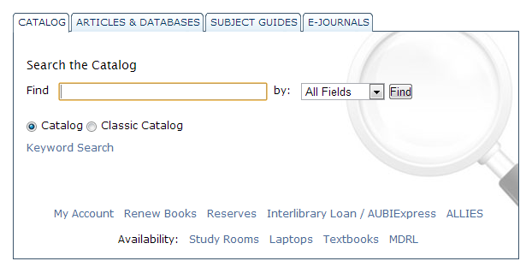
ASERL - Integrated Search
The others have tabbed or tab-like search boxes
Notes:
Most, like Auburn (pictured here) have true tab interfaces – visually the different information resources are represented by tabs

Slide 23
Web-Scale Discovery
A system that integrates local holdings, such as Catalog items (books, media, etc.) and an index of articles, reviews and other data from a central repository
Products include Summon, WorldCat Local, Primo, EDS and Encore

Slide 24
Web-Scale Discovery
Not a “next-generation” catalog
A next-generation catalog, such as VUFind or AquaBrowser, enables access to items, such as digital repositories, that are not always found in a library catalog.
They also enable “Web 2.0” features such as tagging and “faceted” browsing of results
They lack the ability to search article citations
Notes:
This last bullet illustrates the biggest defining factor. While the Web-Scale Discovery system shares the ability to import non-traditional collections, and also incorporates “Web 2.0” technologies, the hallmark of a WSD is the ability to search an indexed database of article citations, and merge those results into results from the catalog and other sources.

Slide 25
Louisiana - Web-Scale Discovery
8 sites feature a web-scale discovery tool
Tulane uses Primo
Xavier has Worldcat Local
La Tech,LSU, LSU-Alexandria,McNeese,Nicholls and UNO have EDS

Slide 26
ASERL - Web-Scale Discovery
31 of the 38 academic library sites feature a web-scale discovery tool
2 use Encore
University of South Carolina | Encore
University of Memphis | Encore

Slide 27
Web-Scale Discovery
31 of the 38 academic library sites feature a web-scale discovery tool
4 use Worldcat
University of North Carolina at Greensboro | worldcat
University of Alabama - Birmingham | worldcat
University of Louisville | worldcat
University of Maryland | worldcat

Slide 28
Web-Scale Discovery
31 of the 38 academic library sites feature a web-scale discovery tool
5 use Primo
Tulane University | Primo
University of Tennessee - Knoxville | Primo
Virginia Commonwealth University | Primo
Emory University | Primo
Vanderbilt University | Primo

Slide 29
Web-Scale Discovery
31 of the 38 academic library sites feature a web-scale discovery tool
7 use EDS
Georgia State University | EDS
Louisiana State University | EDS
University of Alabama | EDS
University of Central Florida | EDS
University of Georgia | EDS
University of South Florida | EDS
Mississippi State University | EDS

Slide 30
Web-Scale Discovery
31 of the 38 academic library sites feature a web-scale discovery tool
13 use Summon
UNC - Chapel Hill | University of Florida
North Carolina State University | University of Miami
Florida International University | University of Mississippi
Clemson University | Virginia Polytechnic Institute and State University
Duke University | Wake Forest University
East Carolina University | University of Virginia
Florida State University

Slide 31
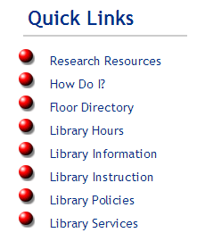
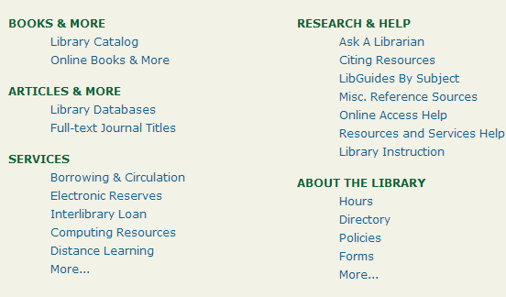
Navigation Design
Grouping of links presented either as heading of drop-down menu or list of links
I encountered several styles of navigation…
Horizontal navigation at the top
Horizontal navigation elsewhere
Vertical Navigation
And some list headings on the home page

Slide 32
Main Navigation
Notes:
Looking primarily at a site’s main navigation scheme. The purpose is to understand different approaches of grouping information. They can either be presented as a vertical navigation bar with drop-down menus, as we did at Tulane. Or they can be presented as headings to groups of visible links.

Slide 33
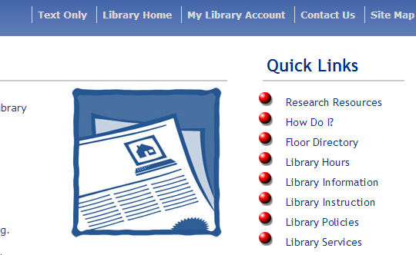
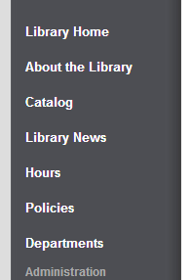
Louisiana - Navigation
12 use vertical menus (most on the left, some on the right)

Slide 34
Louisiana - Navigation
7 use horizontal menus (most on the top)

Slide 35
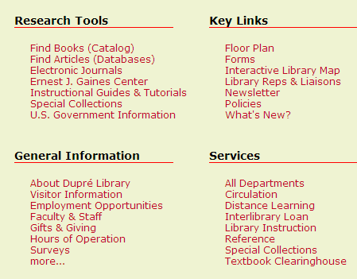
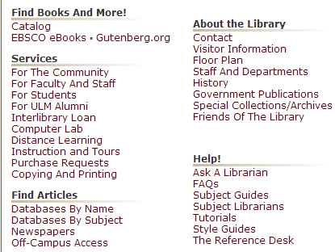
Louisiana - Navigation
2 use list headings

Slide 36
Louisiana - Navigation
In terms of labels, I saw many commonalities
Most commonly used term was “Services” (11)
Next was “About” (8)
“Resources”, “Collections” and “Help” (5)
“Research” used 4 times
Notes:
All about Services!

Slide 37
Louisiana - Navigation
Notes:
All about Services!

Slide 38
ASERL - Navigation
Most (24) have main navigation horizontally …
Notes:
24 Have main navigation horizontally across the top of the page

Slide 39
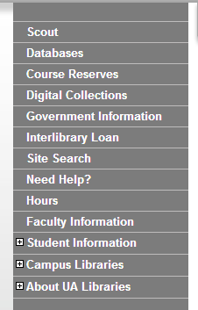
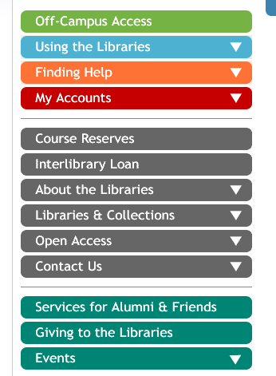
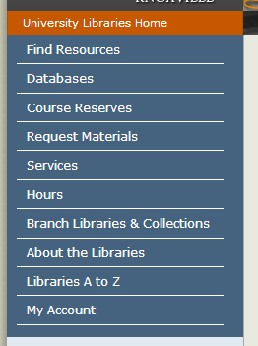
ASERL - Navigation
6 are vertical menus….
Notes:
Alabama, Florida, Tennessee

Slide 40
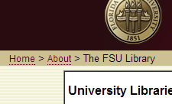
ASERL - Navigation
1 has list headings on the main page…
Combined with bread crumbs internally
Notes:
(2) Florida State and Georgia Tech

Slide 41
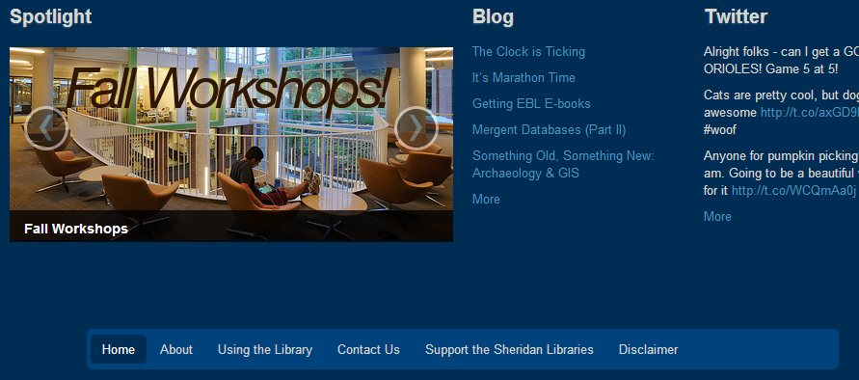
ASERL -Navigation
At Johns Hopkins University, the main nav bar is at the bottom of the page…

Slide 42
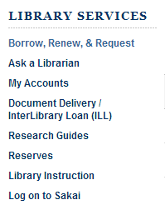
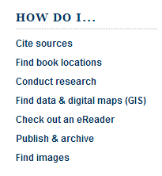
ASERL -Navigation
At Duke University, the closest thing I can find to a main nav bar is this…
But they also have list headings:

Slide 43
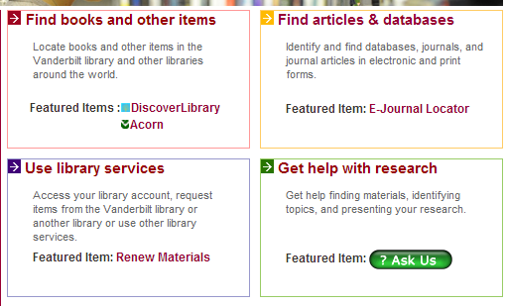
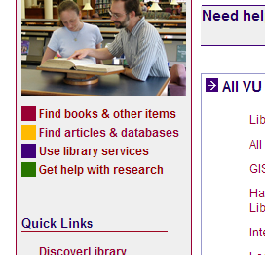
ASERL -Navigation
Very similar at Vanderbilt -
But they also have list headings:
Notes:
And their list headings become navigation on internal pages

Slide 44
ASERL -Navigation
With labels, again many commonalities
Most commonly used term was “Services” (28)
Next was “Research” (22)
“Help” (17)
“Collections” (16)
“Find” (12)
“Hours”(11)
Notes:
All about Services!

Slide 45
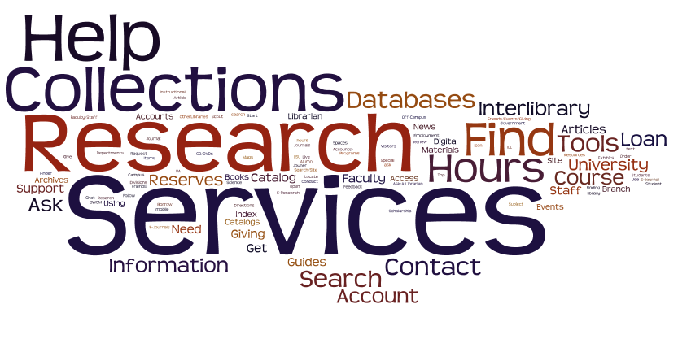
ASERL -Navigation

Slide 46
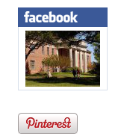
Social Media
Presence of library-maintained social media links on the library home page
Notes:
As social media outlets grow increasingly popular world-wide, many libraries have used Facebook, Twitter and other services to reach patrons.
In this study, I looked for library-specific social media pages linked from a library’s home page.
These examples are from Ull, Centenary, and McNeese

Slide 47
Louisiana - Social Media
13 libraries have links to Social Media on their home pages
12 include Facebook
7 include Twitter
5 include blogs

Slide 48
ASERL - Social Media
34 libraries have links to Social Media on their home pages
(32) Facebook
Twitter (27)
YouTube (18)
Blogs (14)
Flickr (13)

Slide 49
ASERL - Social Media

Slide 50
Questions?

